Slide 1


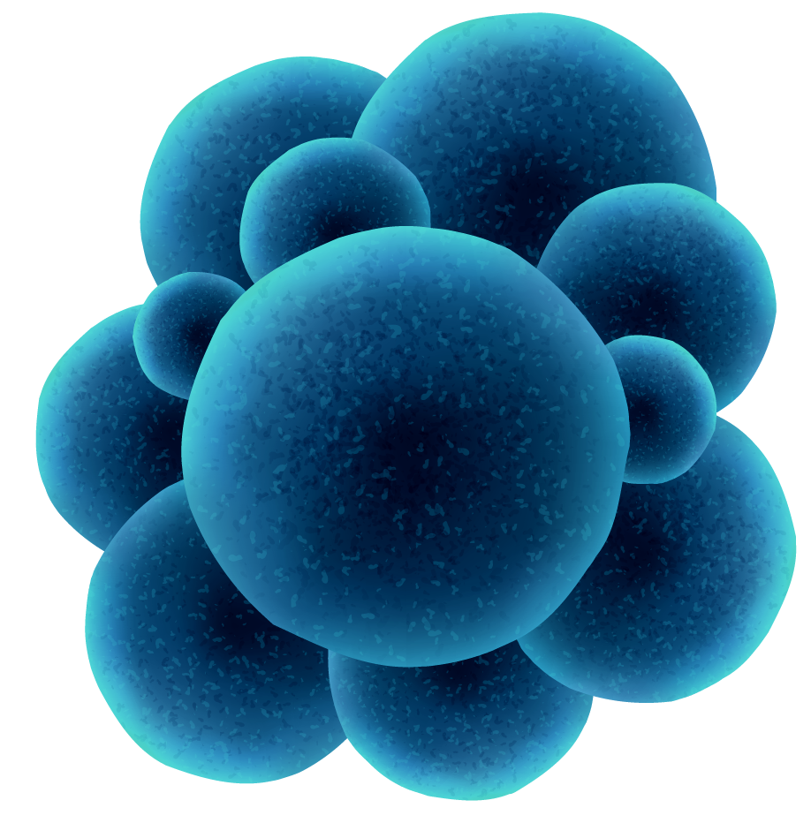
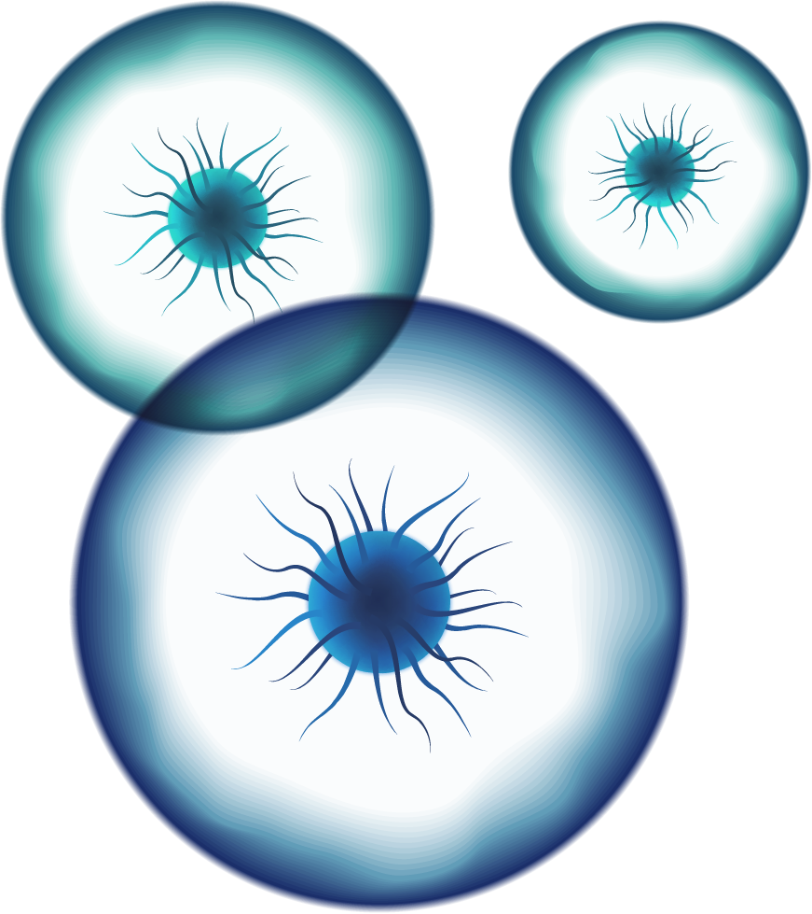

RBP-ID Development of a Web-Based Bioinformatics Tool for the Identification of Phage Receptor-Binding Proteins
Presented by Cátia Rosário
Oriented by Silvio Santos and Óscar Dias

Slide 2
Table of contents
01
02
03
04
05
Milestones
Abstract
Introduction
06
Results
Discussion
Conclusion

Slide 3
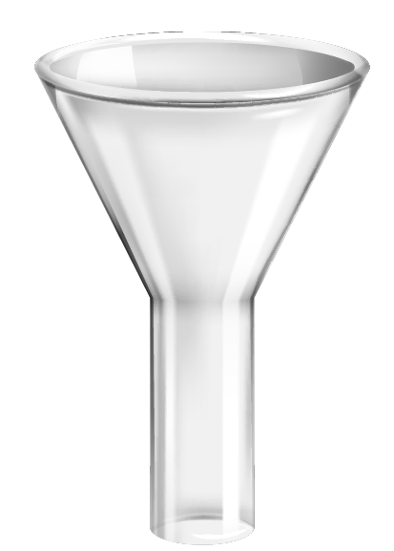
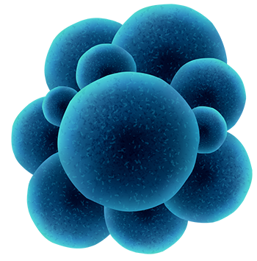


01
Milestones

Slide 4
Milestones reached
Initial Research about the theme
Literature Compilation about Viruses and RBPs
1st Dataset creation with manually compiled RBPs candidates
RBPs Validation through published experimental data
2nd Dataset creation with computationally predicted RBPs from a compilation of Datasets
3nd Dataset creation with computationally predicted and validated RBPs
Initial Bioinformatic Analysis – Clustering with cd-hit and K-means
Initial Bioinformatic Analysis – PCA and Dendrograms

Slide 5
02
Abstract

Slide 6



Abstract
Bacteriophages: Viruses that infect bacteria with key roles in biotechnology and medicine.
Receptor-Binding Proteins (RBPs): Determine host specificity by mediating bacterial recognition and attachment.
Challenge: RBPs exhibit high sequence diversity and low conservation, making identification difficult.
Solution – RBP-ID: A web-based bioinformatics tool for systematic RBP prediction in phage genomes.

Slide 7
03
Introduction

Slide 8
Introduction
Background
Importance
Phage display & delivery systems: Technologies for gene editing and therapeutic biomolecule delivery.
Adaptation mechanisms: Co-evolution with bacteria through receptor mutations and CRISPR-Cas defence systems.
Computational tools for phage genome annotation:
Hybrid approaches: HMM searches and ML classifiers
Host prediction via RBP analysis: Random Forest and SVMs, XGBoost
PHYPred: Functional annotation tools for phage-encoded enzymes
PhANNs
Biotechnological & therapeutic: Antibiotic resistance solutions, microbiome engineering, biosensing and precision medicine
Phages vs. antibiotics: Target specific pathogens without harming beneficial bacteria, a key advantage in antimicrobial resistance (AMR)
Synthetic biology advances: Engineered phages and phage-derived enzymes broaden applications in medicine, agriculture, and industry
Need for advanced bioinformatics tools

Slide 9
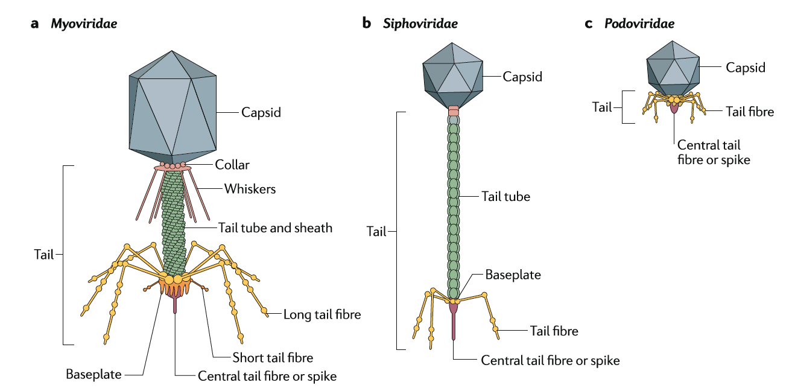
Tail Fibre World
a Myoviridae b Siphoviridae c Podoviridae
Morphotypes
Short, Long, Spikey, Contractile, Non-Contractile

Slide 10
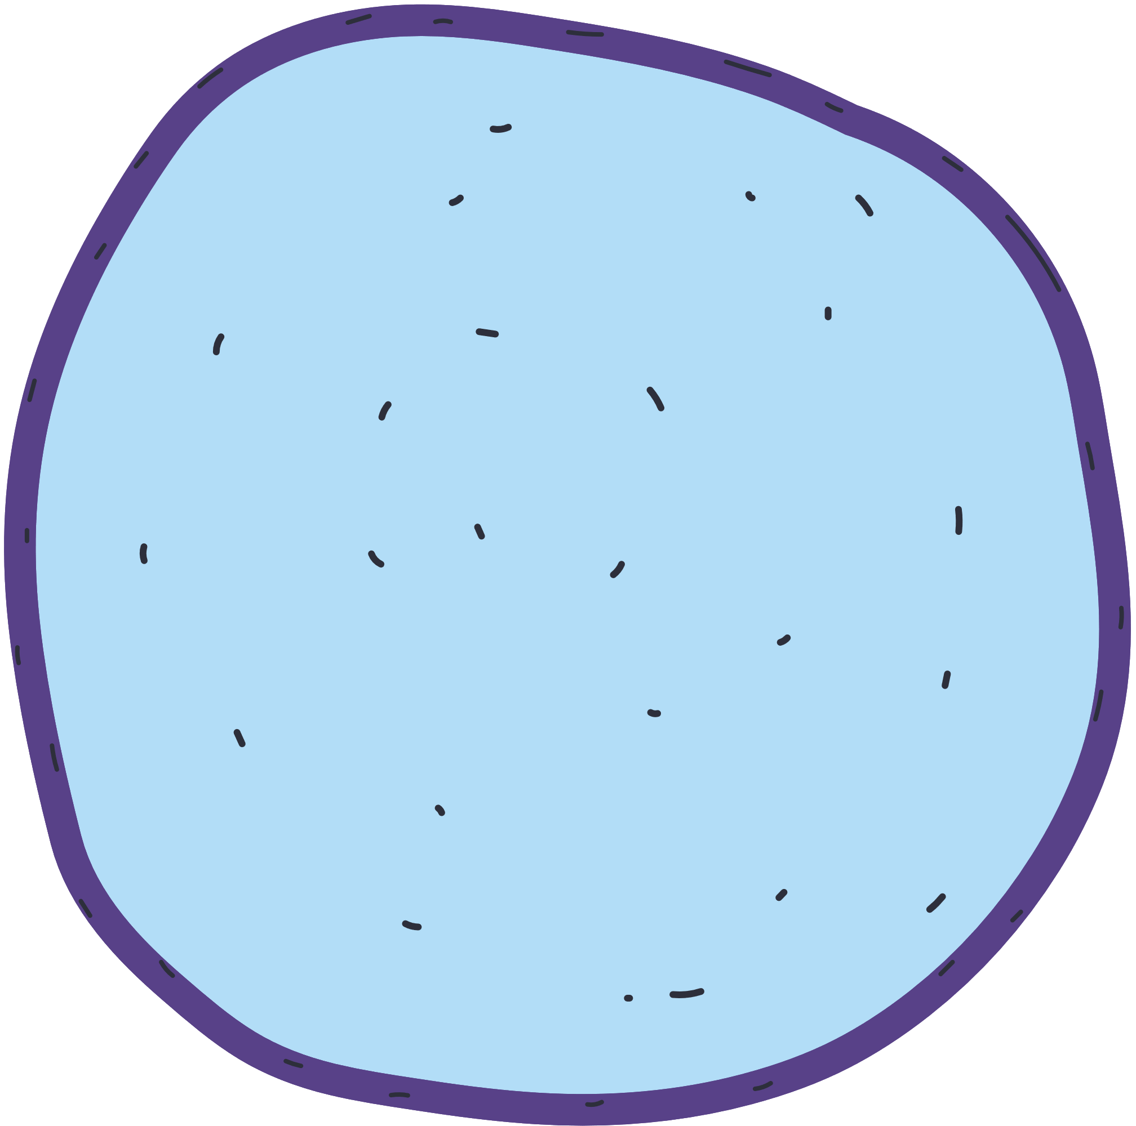



HOW DO VIRUSES REPLICATE
The virus’s genetic material reprograms the host’s DNA and starts to replicate itself
When the host cell is filled with virus copies, it bursts, releasing them into the bloodstream to repeat the process
The virus invades the host cell
The virus injects its genetic material into the host cell

Slide 11
04
Results

Slide 12
4.1
1st Dataset

Slide 13
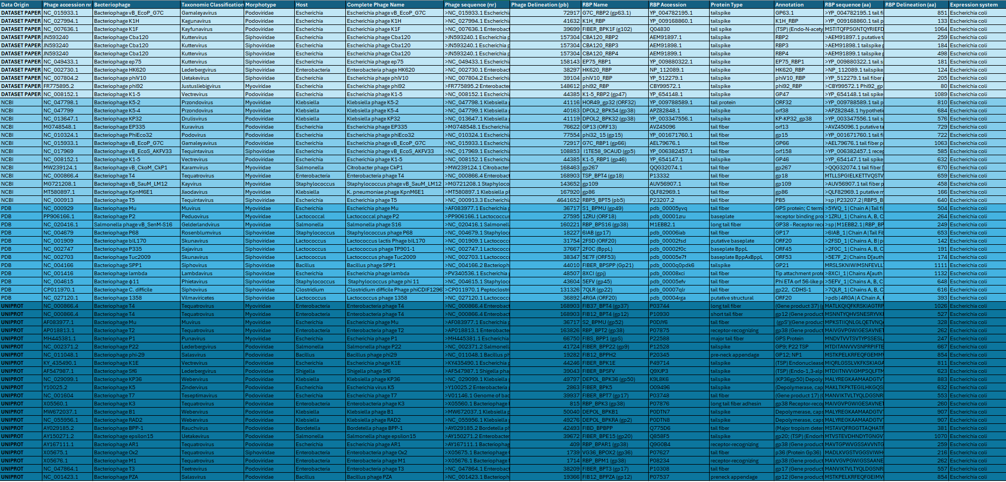
1st Dataset – Validated RBPs

Slide 14
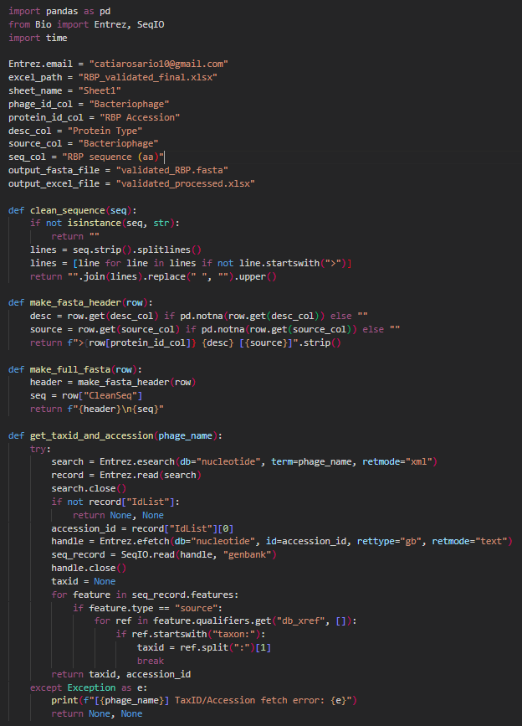
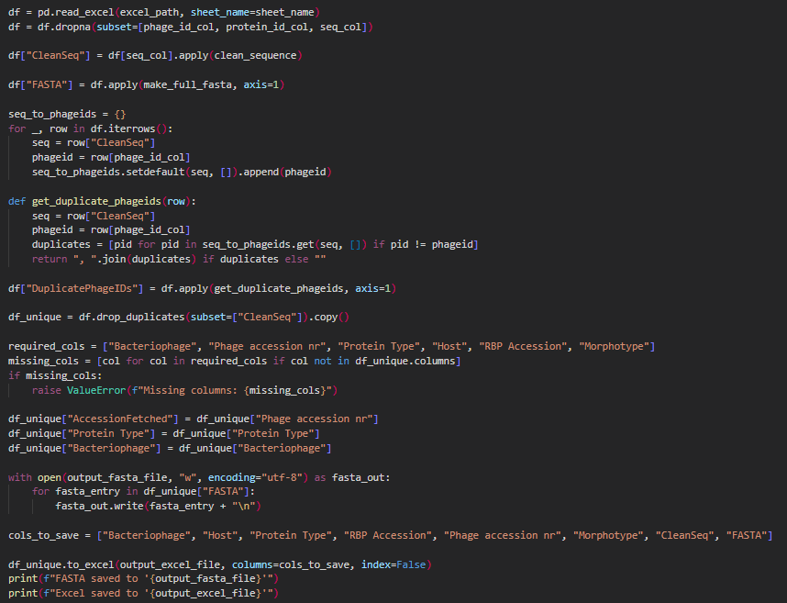
Validated RBPs - Processement with Python
Workflow data processing - VALIDATED:
- Add FASTA format when missing
- Create a column with only aa to remove duplicates
- Create column with FASTA format to create FASTA file
- Create column with duplicated identifiers when found
- Remove duplicate lines based on sequence
- Create FASTA file and Excel file

Slide 15
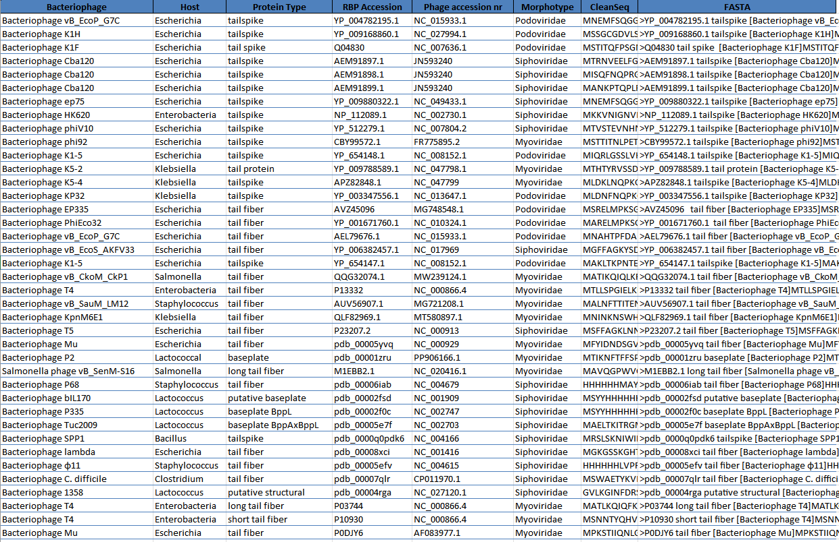
Validated RBPs after Processement with Python

Slide 16
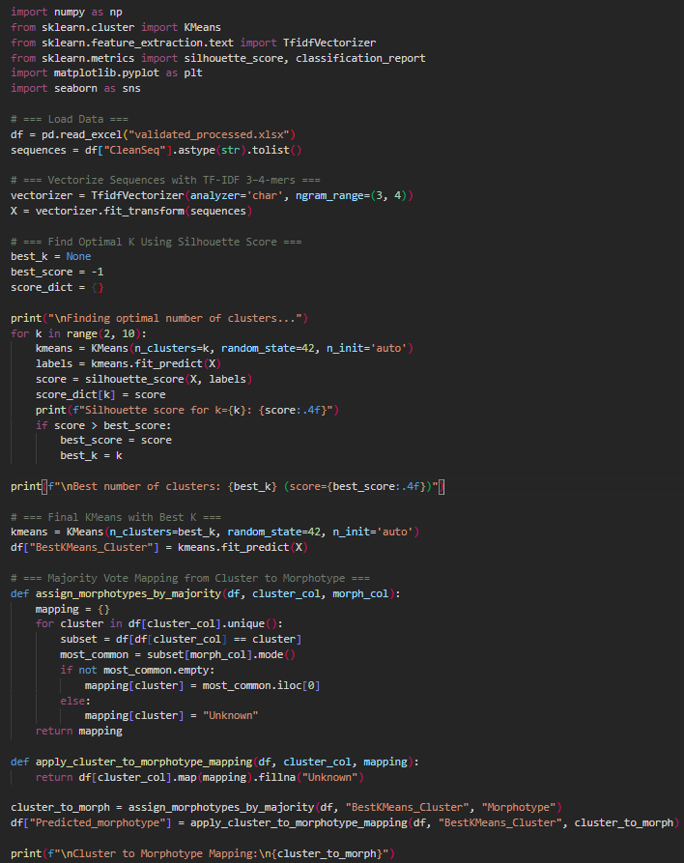
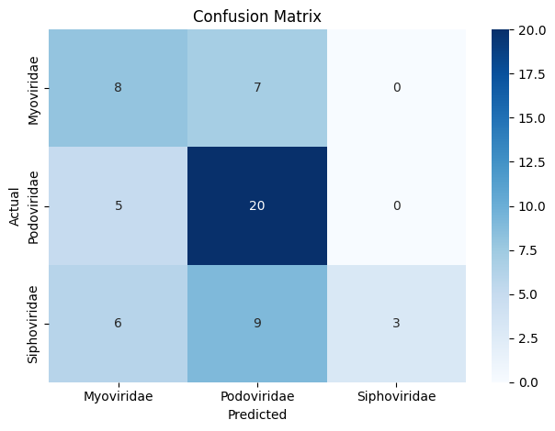
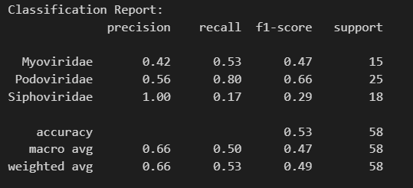
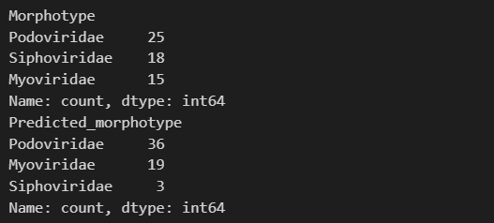
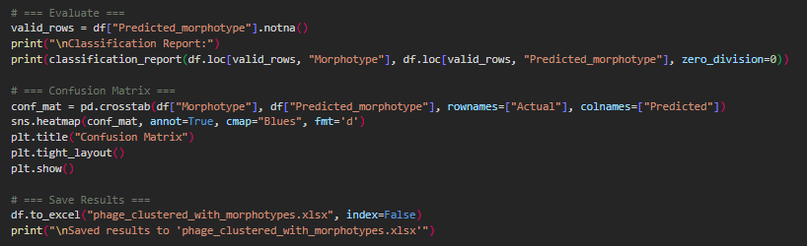
Validated RBPs Analysis K-means and Confusion Matrix
Performance Analysis:
Podoviridae:
Highest recall and f1-score
↓
Reliably identified
Myoviridae and Siphoviridae:
Weaker performance;
Low recall for Siphoviridae
↓
Potential issues in
classification

Slide 17
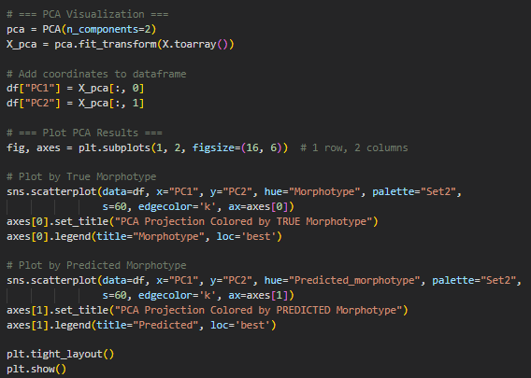
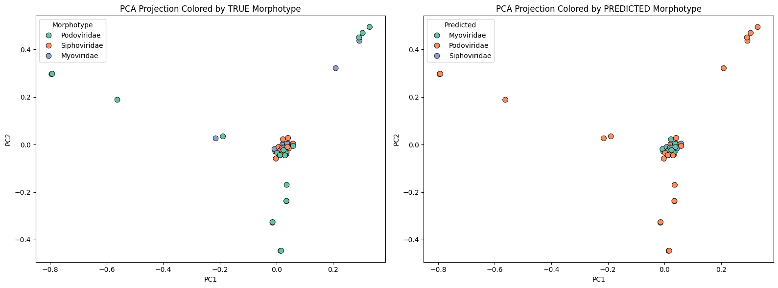
Validated RBPs – PCA and Clusters
PCA - TRUE Morphotype Clusters:
Podoviridae: Well-separated
Siphoviridae: Cluster closer to Myoviridae
Myoviridae: Not clearly distinct; Slightly overlapping with Siphoviridae
Distinct clustering for Podoviridae
Confusion/blending between Siphoviridae and Myoviridae
PCA - PREDICTED Morphotype Clusters:
Podoviridae: New clustering observed, likely misclassified from the TRUE representation.
Siphoviridae: Predicted model seems less accurate
Myoviridae: Some appear clustered together with Podoviridae
Predictive model not capture morphotype distinctions effectively

Slide 18
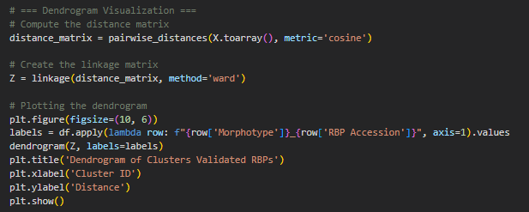
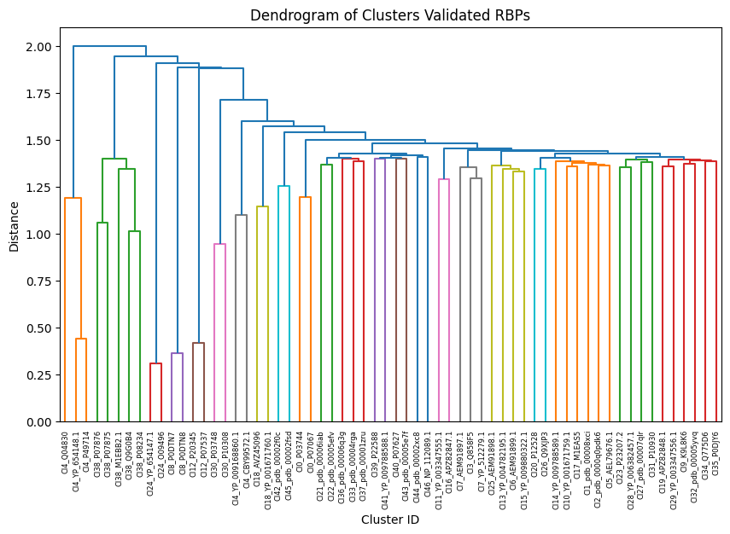
1st Dataset – Dendrogram K-means
For global compositional similarity - identifying potential functional groups:
Cluster shape: Compact, evenly sized clusters
Separation between clusters: Distinct groups shared sequence features
Reflecting functional or structural similarity, even among non-homologous proteins - spacing on the left side indicate relationships among RBPs
Clustering suggests distinct groups among the validated RBPs – some by morphotype

Slide 19
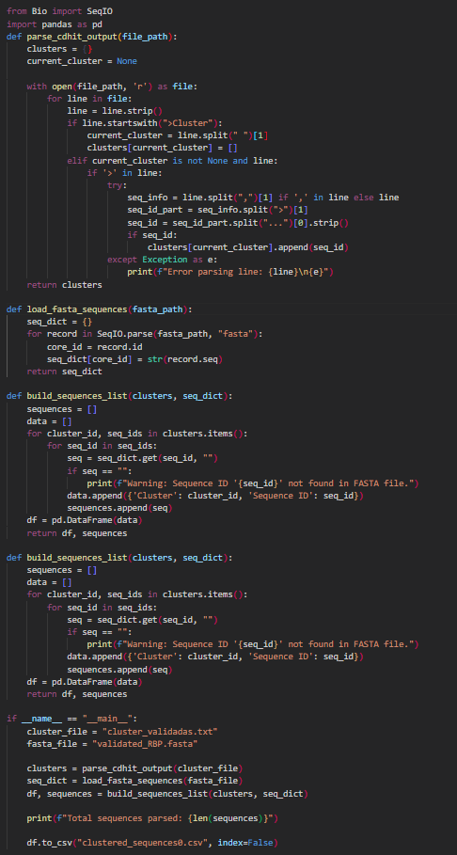
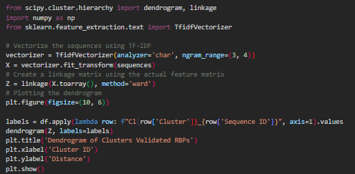
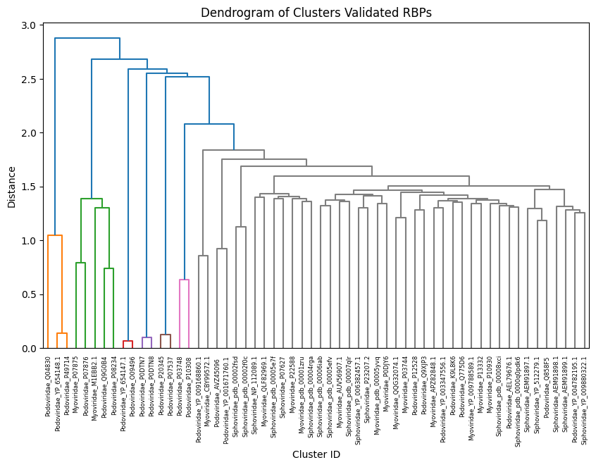
1st Dataset – Validated RBPs CD-HIT
For redundancy removal and homology grouping:
Pairwise sequence identity
Cluster shape: Broader clusters
Separation: Some branches merging at higher distances = low sequence similarity
Bifurcations at grey represent a bigger diversification in less time comparing with the pink cluster with same ancestry
Clustering suggests distinct groups among the validated RBPs – some by morphotype

Slide 20
4.2
2nd Dataset

Slide 21
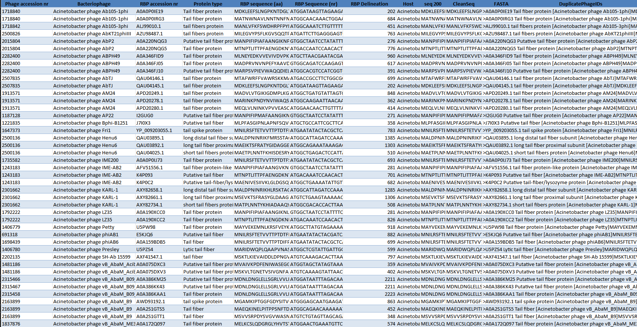
2nd Dataset – Computationally Predicted RBPs

Slide 22
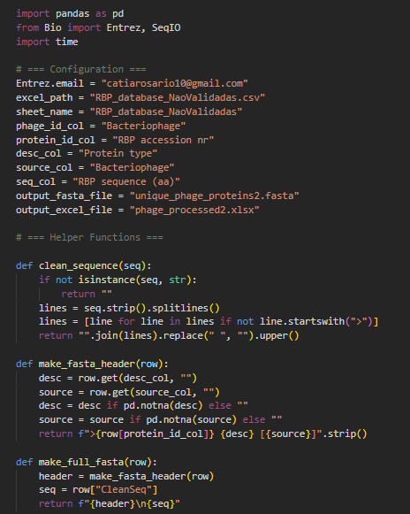
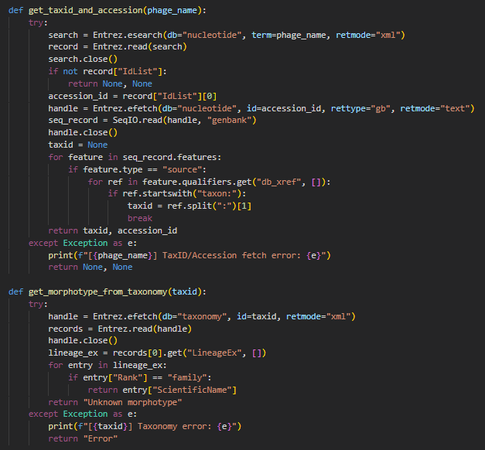
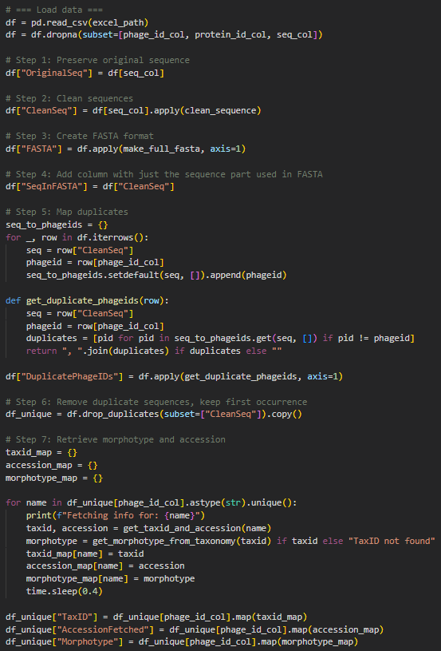
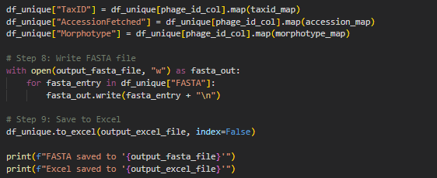
2nd Dataset Processement with Python
Workflow data processing – NON-VALIDATED:
- Fetch the id of bacteriophages from name
- Add column with ids
- Add FASTA format if missing
- Create column with only aa to remove duplicates
- Create column with FASTA format
- Create new column with duplicated identifiers
- Remove duplicate lines based on sequence
- Retrieve morphotypes
- Create FASTA file and Excel file

Slide 23
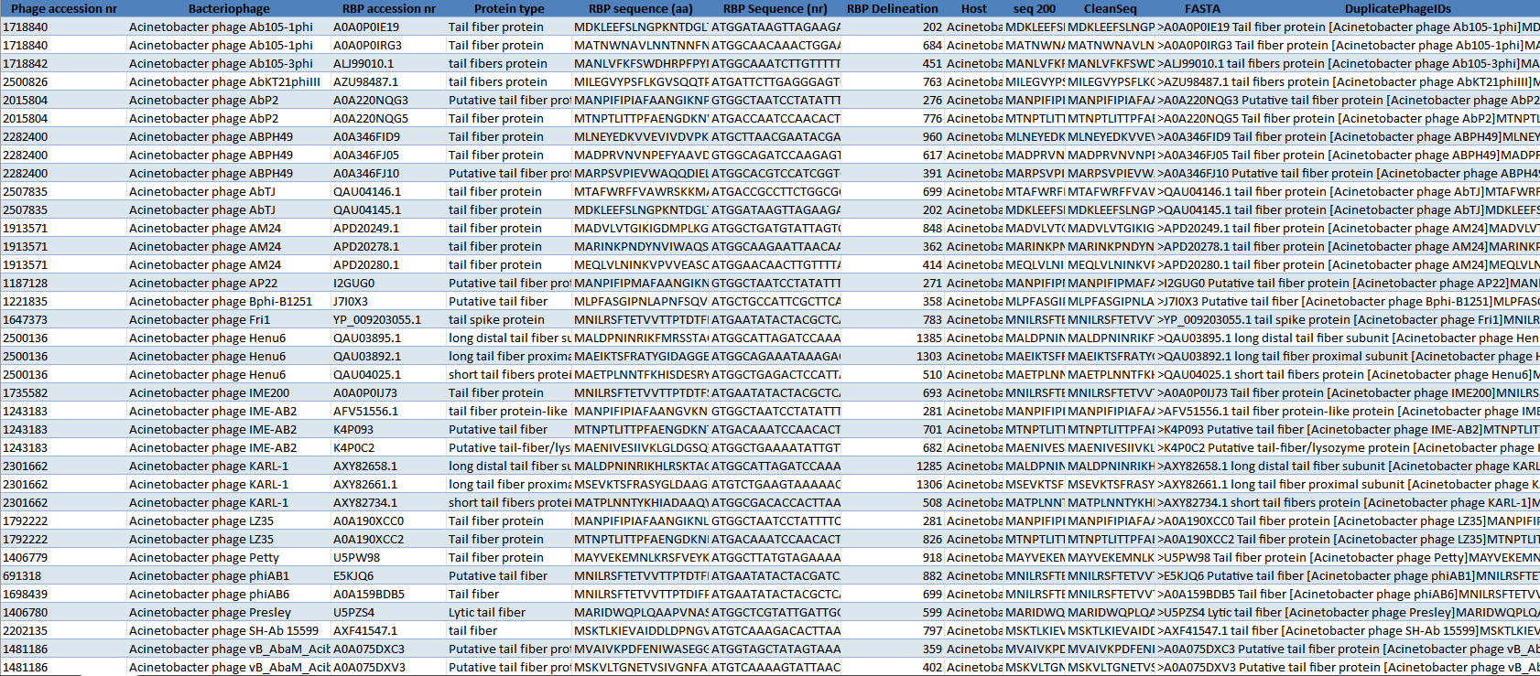
Computationally Predicted RBPs after Processement with Python

Slide 24
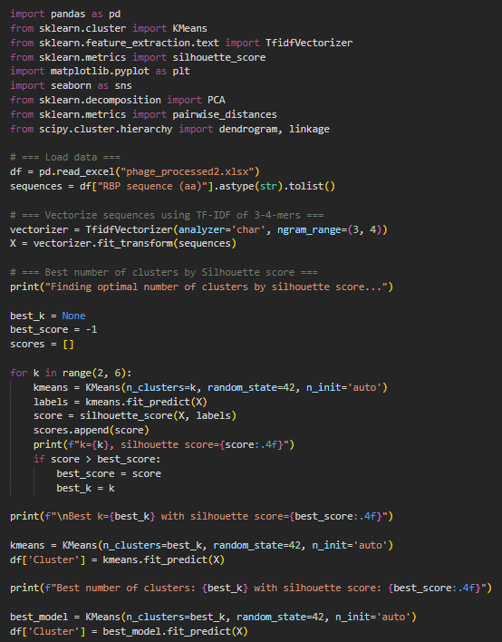
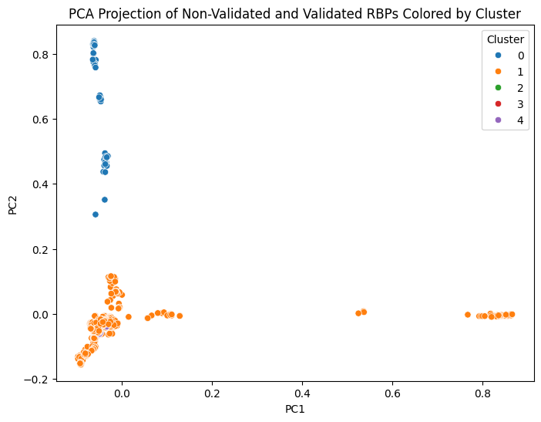
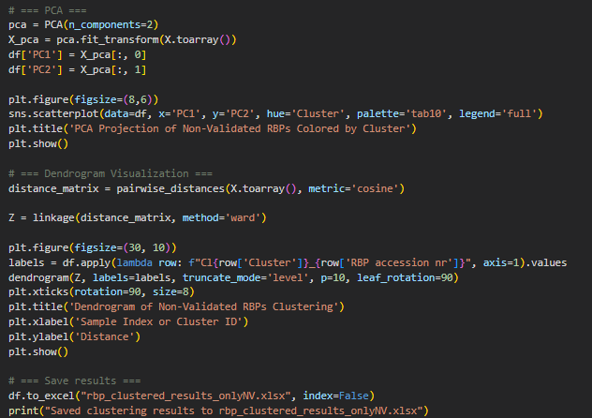
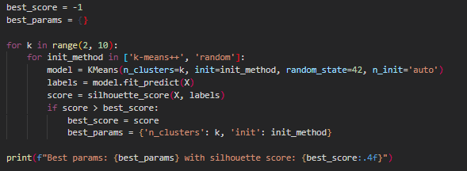
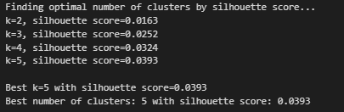
2nd Dataset Analysis - K-means and PCA
Cluster 0:
Separated from others → distinct characteristics
Cluster 1:
Larger group with some spread along both axes
Cluster 2, Cluster 3, Cluster 4:
Less populated and overlap → similarity in characteristics
Interpretation:
- Distinct clusters → Non-Validated RBPs may have different characteristics
- Cluster 0 is notably distinct, potentially representing a unique group of RBPs

Slide 25
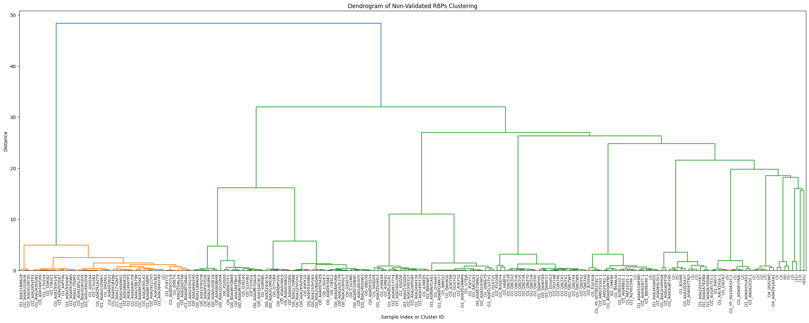
2nd Dataset Analysis - Dendrogram
Orange cluster: Less variation within each group. Branches with short distances before splitting
Green cluster: More variation within each group. Green branches span wide distances before splitting
- Dissimilar sequences that share functional elements
These clusters likely represent:
Possibly novel or divergent RBPs
Groupings of functionally analogous
- Cluster shape: Broad
- Separation between clusters: High
- Cohesion between sub-groups
- Nº Clusters: Low

Slide 26
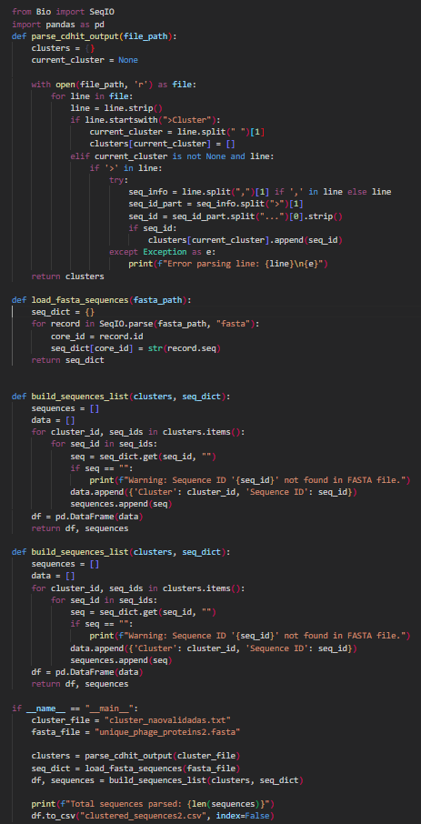
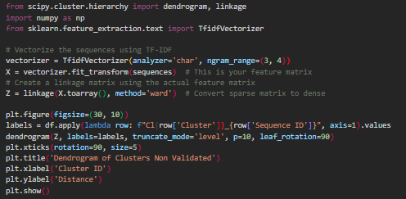
2nd Dataset – Non-Validated RBPs CD-HIT

Slide 27
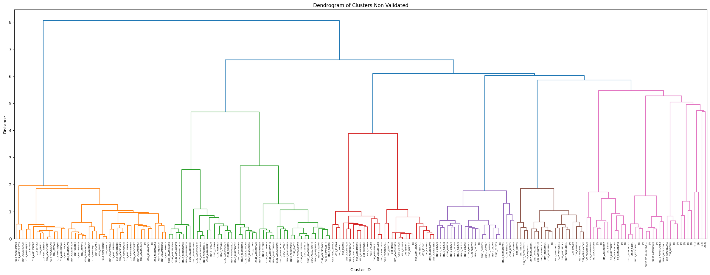
2nd Dataset – Non-Validated RBPs CD-HIT
Groups with many close sequences may indicate conserved subfamilies.
Many sequences <1 → implies high sequence identity
- Cluster shape: Compact, narrow (short branches within)
- Separation between clusters: High (clear distinction)
- Intra-cluster similarity: High (identity ≥ 40%)
- Inter-cluster difference: High (hard cutoff)
Each cluster could correspond to:
- One phage RBP subtype,
- A known structural domain or tail fiber class,
- Evolutionary lineages with strong sequence conservation.

Slide 28
4.3
3rd Dataset

Slide 29
3nd Dataset – Computationally Predicted and Validated RBPs

Slide 30
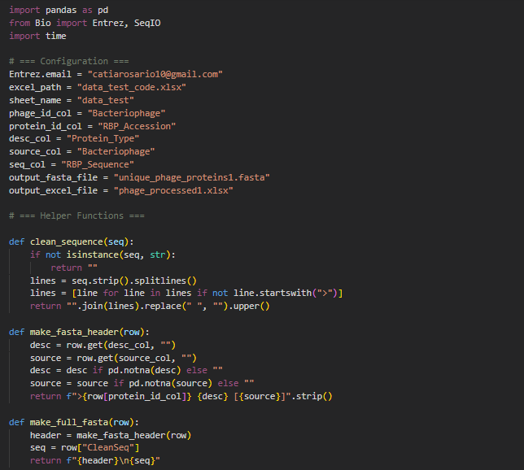

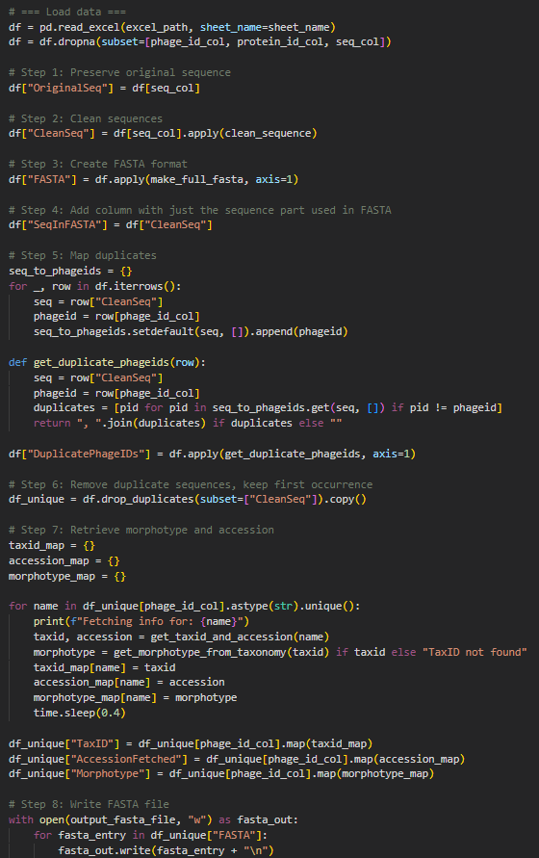

3rd Dataset Processement with Python
Workflow data processing – NON-VALIDATED:
- Fetch the id of bacteriophages from name
- Add column with ids
- Add FASTA format if missing
- Create column with only aa to remove duplicates
- Create column with FASTA format
- Create new column with duplicated identifiers
- Remove duplicate lines based on sequence
- Retrieve morphotypes
- Create FASTA file and Excel file

Slide 31
Computationally Predicted and Validated RBPs after Processement with Python

Slide 32
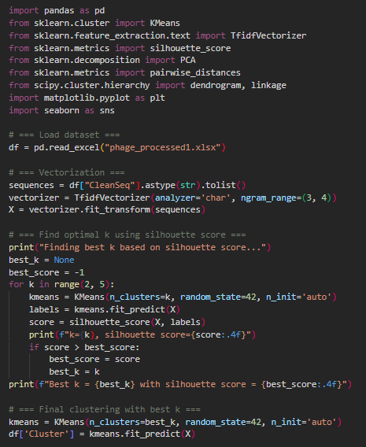
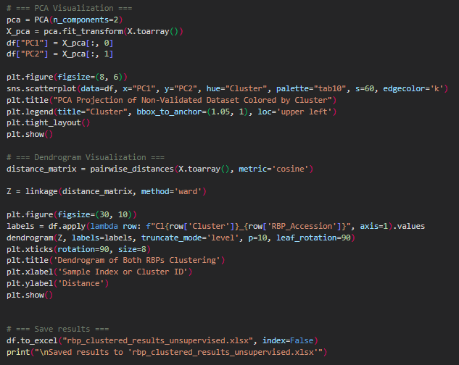
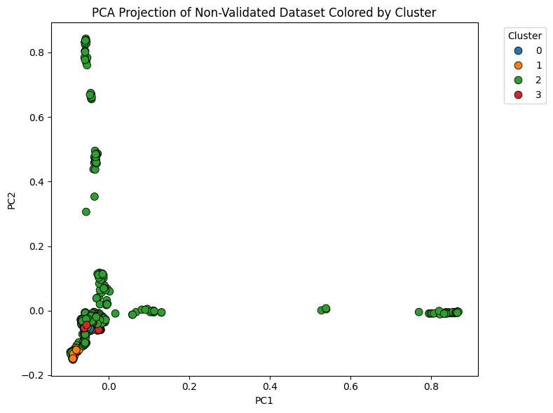
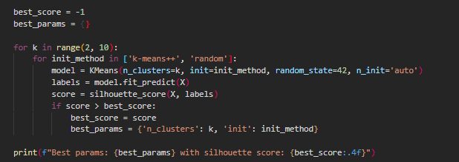
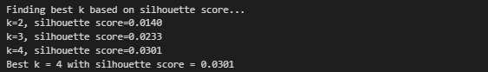
3rd Dataset Analysis - K-means and PCA
Cluster 0:
Numerous points but overlaps with Cluster 2
Cluster 2:
Has most points → dominant cluster in this dataset
Cluster 1, Cluster 3:
Less populated and overlap → similarity in characteristics
Interpretation:
- Distinct clusters → Validated and Non-Validated RBPs may have different characteristics

Slide 33
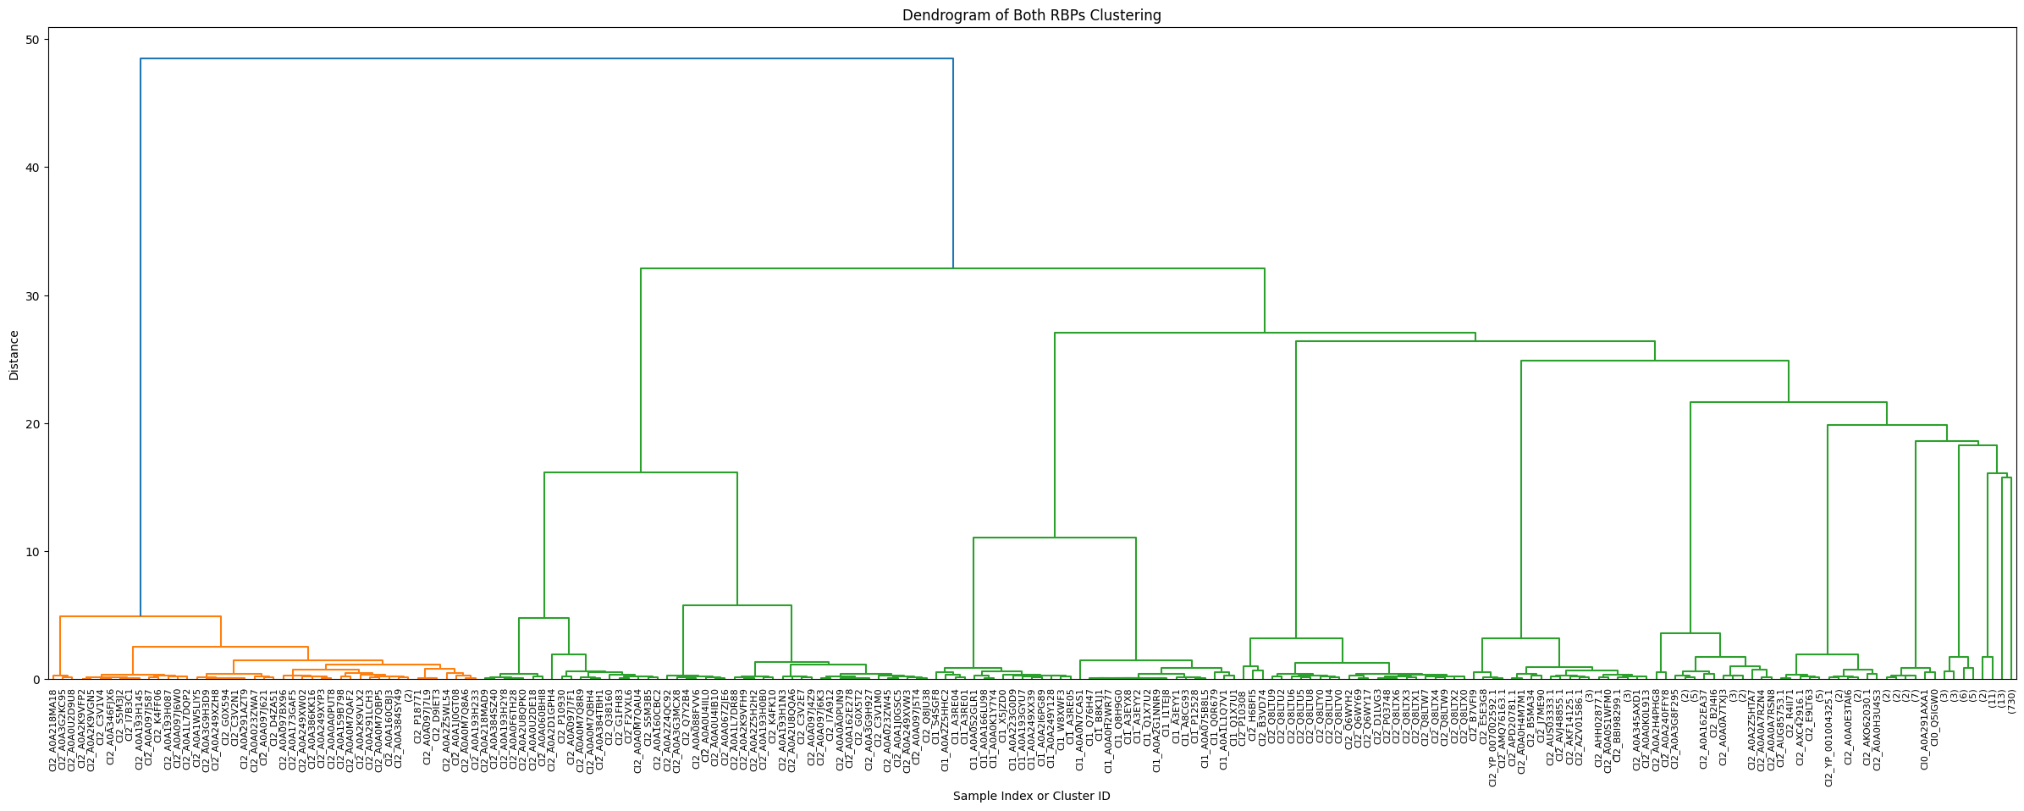
3rd Dataset Analysis - Dendrogram
Orange cluster: Less variation within each group. Branches with short distances before splitting
Green cluster: More variation within each group. Green branches span wide distances before splitting
- Dissimilar sequences that share functional elements
These clusters likely represent:
Possibly novel or divergent RBPs
Groupings of functionally analogous
- Cluster shape: Broad, with higher internal variation
- Separation between clusters: High
- Cohesion between sub-groups
- Nº Clusters: Low

Slide 34
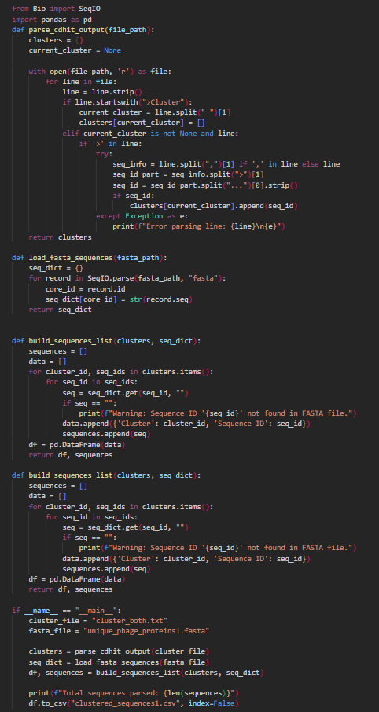
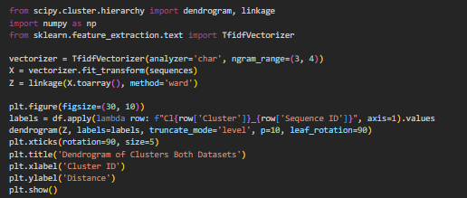
3rd Dataset – Both RBPs CD-HIT

Slide 35
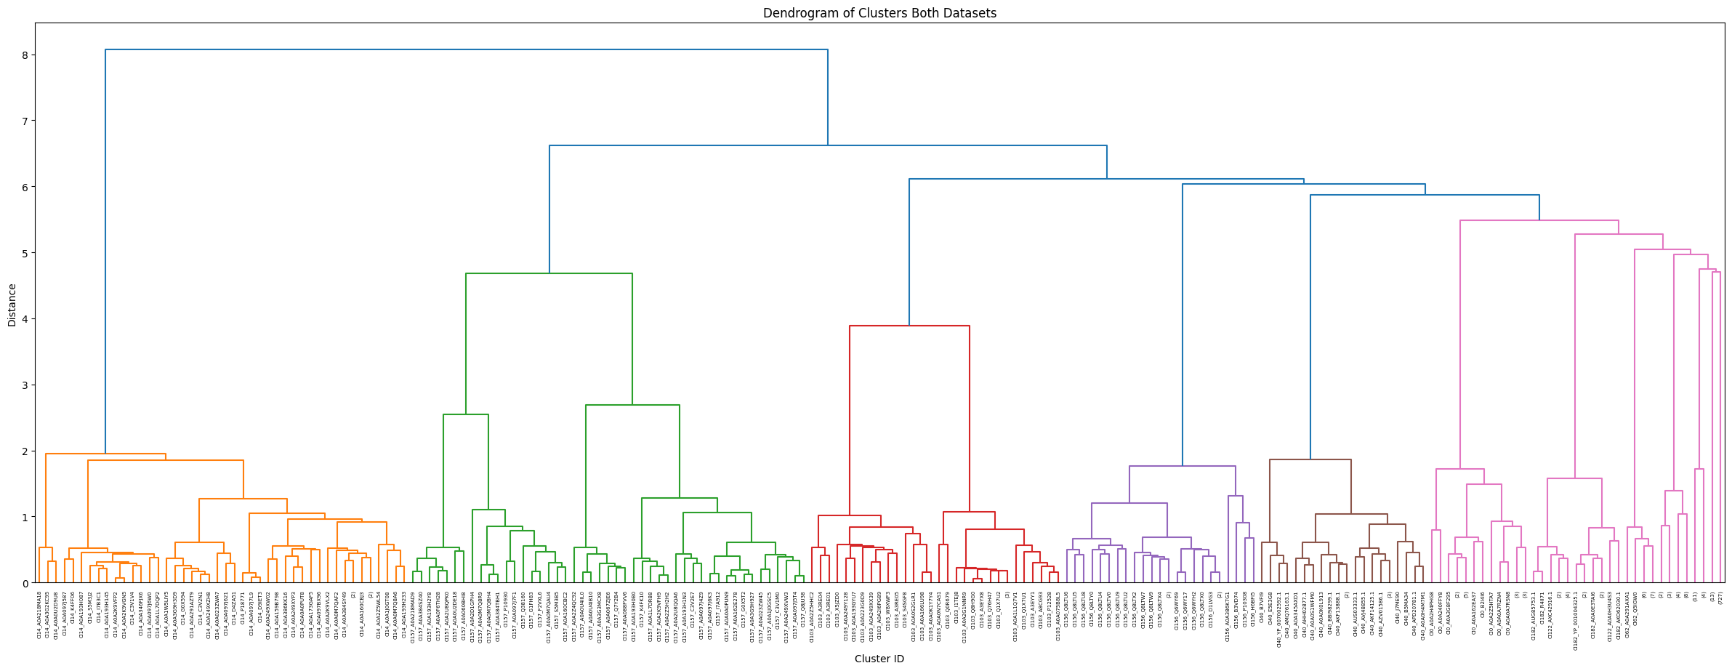
3rd Dataset – Both RBPs CD-HIT
Groups with many close sequences may indicate conserved subfamilies.
Many sequences <1 → implies high sequence identity
- Cluster shape: Compact, narrow (short branches within)
- Separation between clusters: High (clear distinction)
- Intra-cluster similarity: High (identity ≥ 40%)
- Inter-cluster difference: High (hard cutoff)
Each cluster could correspond to:
- One phage RBP subtype,
- A known structural domain or tail fiber class,
- Evolutionary lineages with strong sequence conservation.

Slide 36
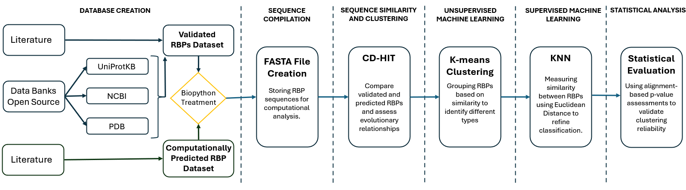
PROJECT WORKFLOW

Slide 37
05
Discussion

Slide 38
Discussion
Challenges
Success
Creation of the provisory datasets:
- Filter and selection of RBPs from the 3 Databases
- Automatization of morphotype retrieval
- Datasets Uniformization
Validation of RBPs:
- Literature key word identification
- Explicit experimental data
Curated RBP Database:
- Two datasets with Validated RBP and RBP candidates
Implemented dual clustering approaches:
- CD-HIT (identity-based): Captured conserved structural/evolutionary groups
- K-Means (motif-based): Revealed functional similarity based on k-mer features
Visualized clustering via dendrograms:
- Assess sequence relationships

Slide 39
06
Conclusion

Slide 40
Conclusion
Next Steps
Vision
Propythia - platform for the classification of biological sequences (proteins and DNA) using machine and deep learning
Train classifiers using validated clusters as labels
Deploy the RBP-ID web Based tool
Enable user input and visualization, returning predicted RBP status, cluster info, and motifs
Expand the validated dataset via literature mining
RBP-ID aims to become a go-to platform for phage researchers, accelerating discovery of receptor-binding proteins for synthetic biology, diagnostics, and phage therapy

Slide 41
Thanks

